Slide 1
Ontario License Plate Extraction Project
Shuaichen Yan
400118470
April 11, 2022

Slide 2
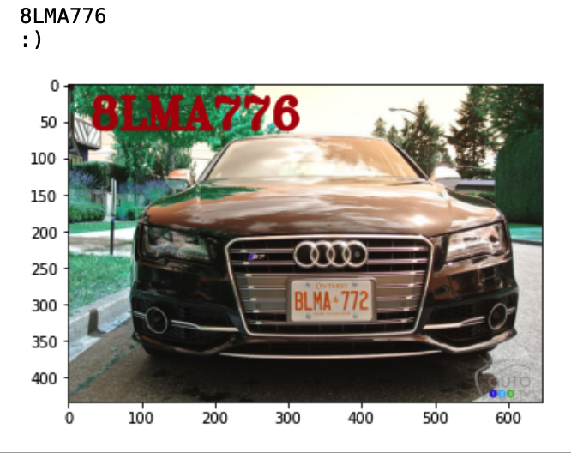
Introduction
OpenCV
+
Python
+
Machine Learning
+
COMPENG 4TN4
=
Ontario License Plate Extraction Project

Slide 3
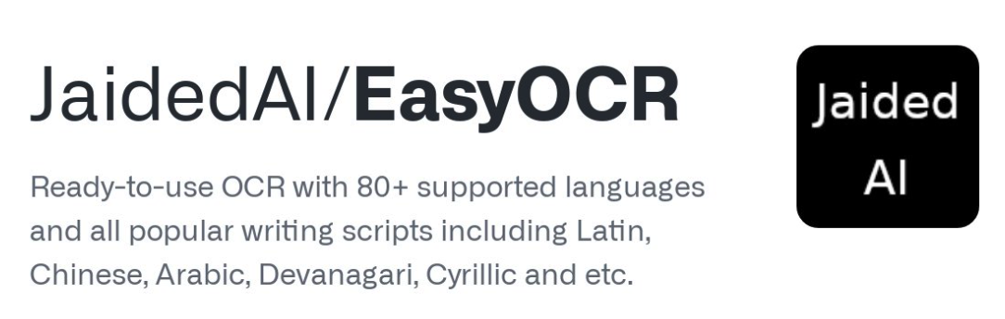
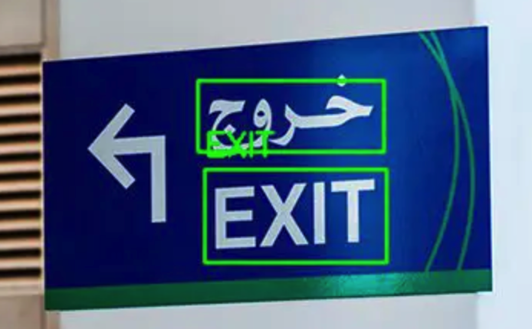
Related Work
Jaided AI
easyOCR
Multi-Language
High Accuracy

Slide 4
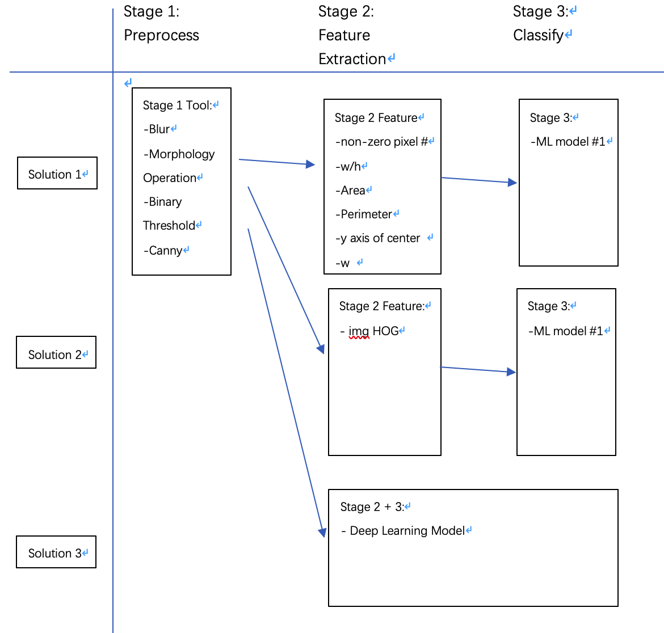
Proposed Method

Slide 5
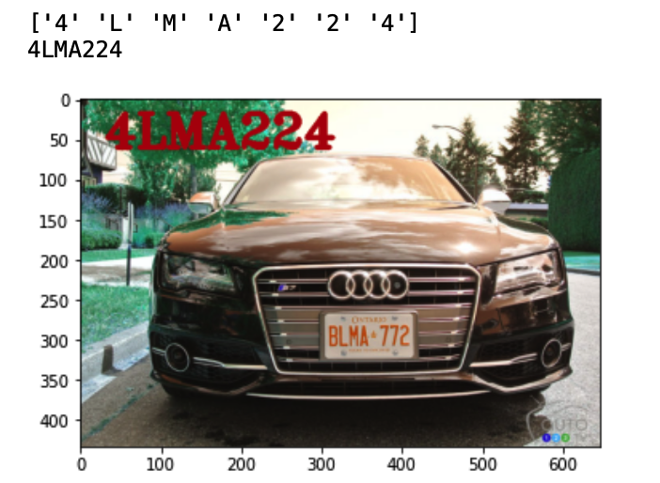
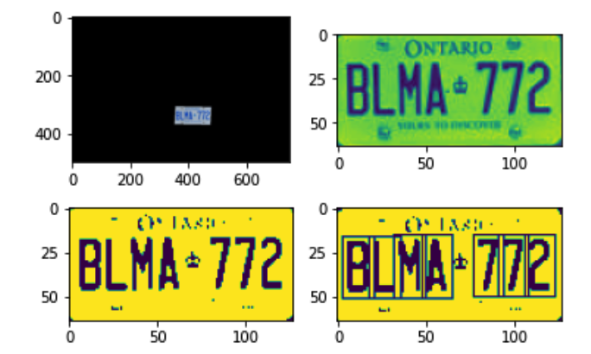
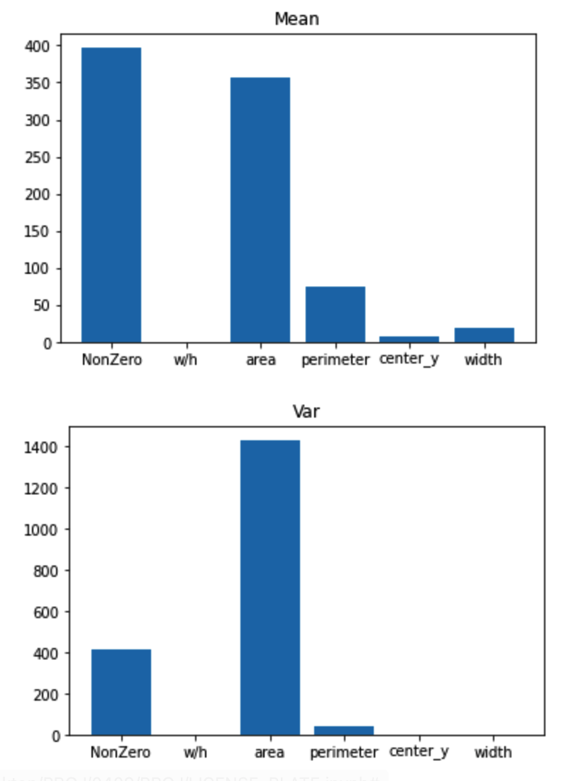
Experimental Results-Method 1 (Main Approach)
Use ML model trained on 6-features to predict license

Slide 6
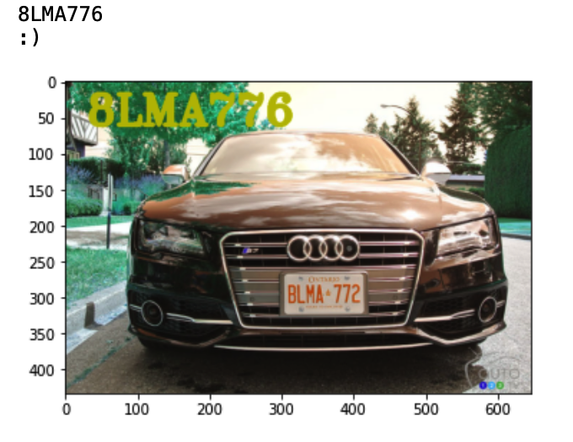

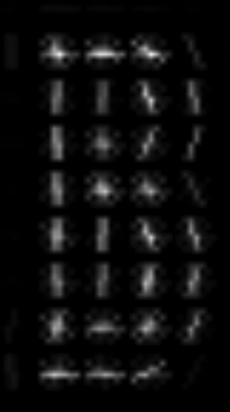
Experimental Results-Method 2
Use ML model trained on HOG to predict license

Slide 7
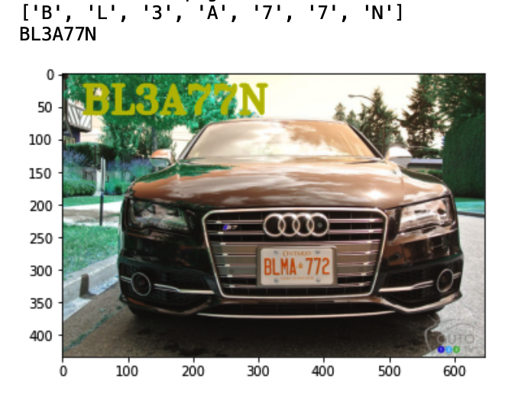
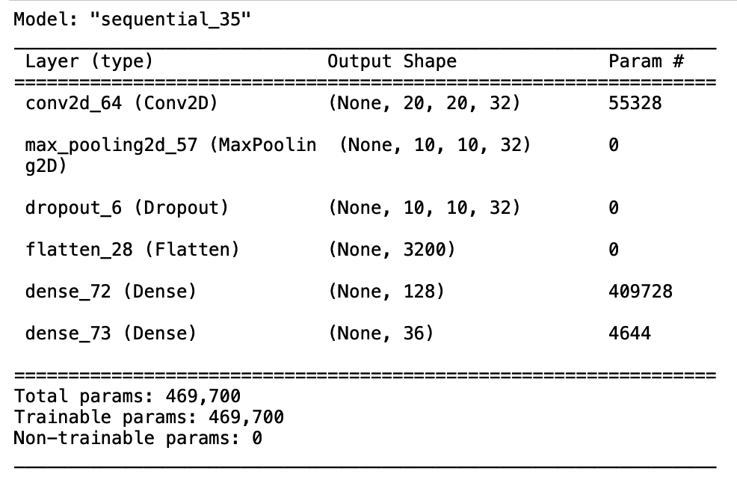
Experimental Results-Method 3 Deep Learning
Use DL model to predict license

Slide 8
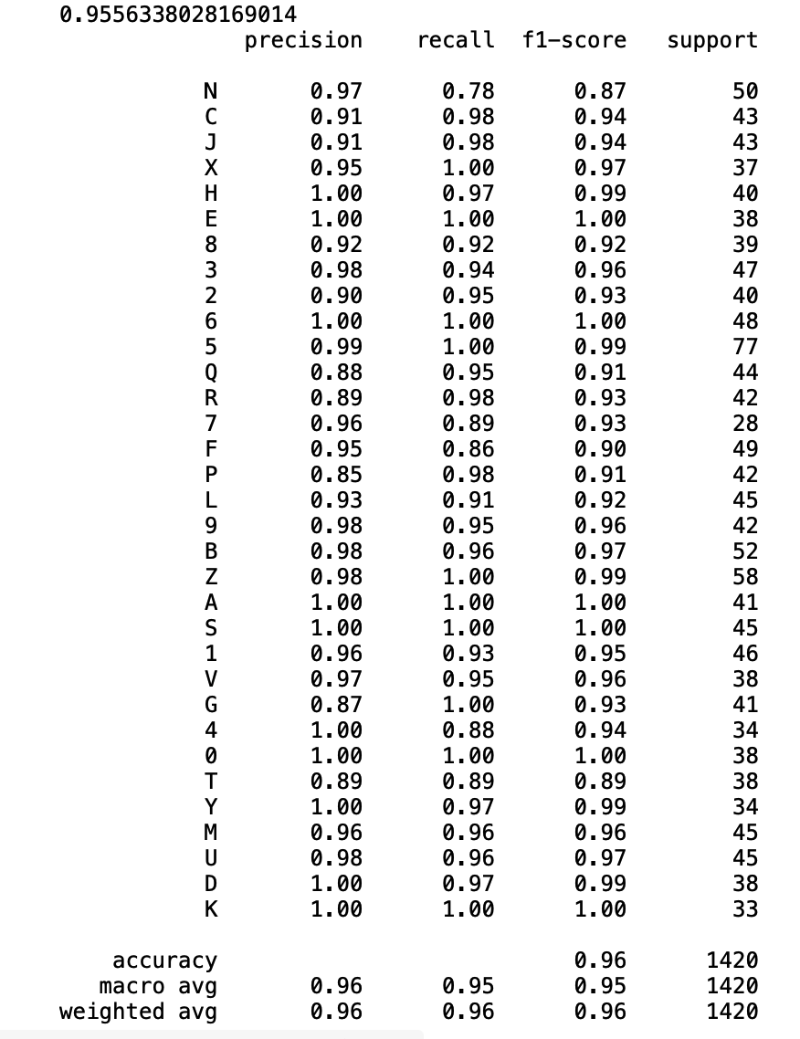
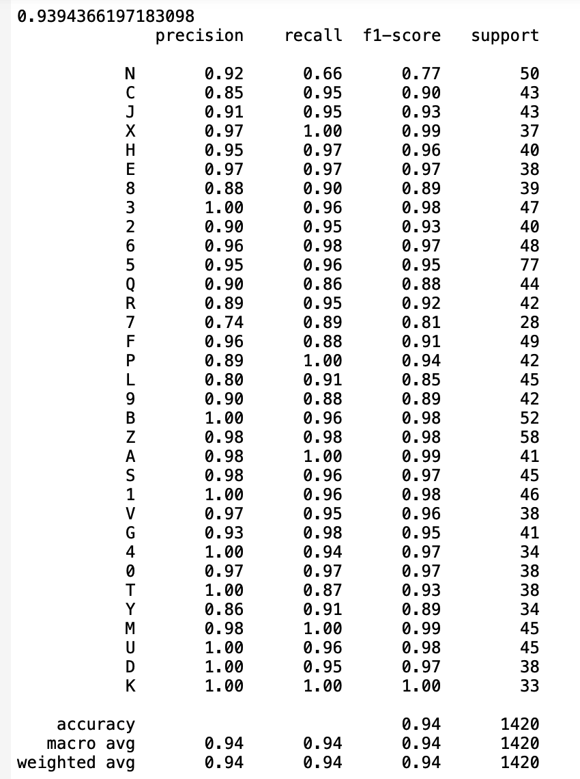
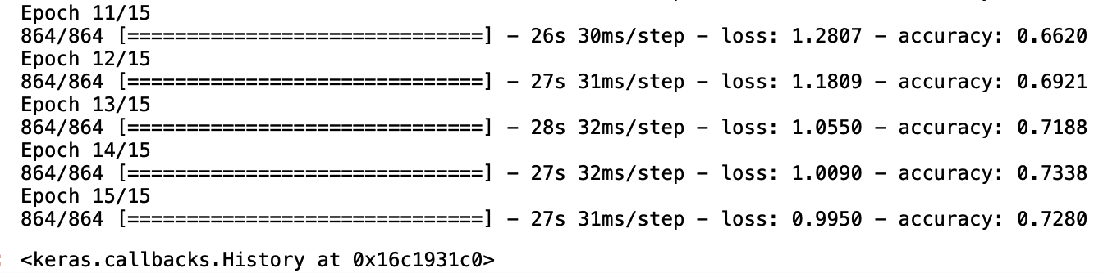
3 Models accuracy comparison
6 feature ML 3/8 HOG ML 5/8 DL 5/8

Slide 9
Conclusion
2 ML model + 1 DL model
High test accuracy
Improvements for Ontario License Plate:
Bigger or specific data set
Tune more robust model
More epoch for DL model

Slide 10
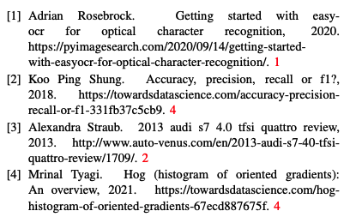
Reference

